Slide 1
Online Book Store
Presented By:-
53 – Pranaj Patil
54 – Prashant Nagawade
55 – Prathmesh Kanaskar
56 – Pratibha Kokil
57 – Pratik Jadhav
Project Guide:- Mrs. Suraja PK

Slide 2
Abstract
Online Book Store (OBS) a web application where customer can purchase books online by web browser.
A customer can create an account & sign in by using login credentials.
Customer can search book by title.
Can add the books into shopping cart.
Purchase the books.
A system administrator to approve and reject request for new books and maintains list categories.
Administrator can confirm the order which is placed by customers.

Slide 3
Objectives:-
A main objective of Online Book Store (OBS)is to provide an essence of online book store via a simple and yet powerful medium.
The project has been designed to simulate the actual working of an E-commerce website.

Slide 4
Requirements:-
Hardware Requirements
Processor: Dual-Core processor or higher
RAM: 4 GB or higher
Hard Disk Space: 500 GB or higher
Software Requirements
Operating System: Windows 10 or higher, or Linux (Ubuntu or Fedora)
Server: Apache tomcat server
Database: MySQL
Programming Language: Java
Framework: Spring Boot
Web Browser: Google Chrome, Mozilla Firefox, Microsoft Edge
Internet Connectivity: Broadband Internet Connection.

Slide 5
Technologies:-
Front end technologies:
HTML, CSS & Bootstrap.
JavaScript & JQuery
Backend technologies:-
Spring Boot App
JSP (Java Server Page)
Hibernate
JPA (Java Persistence API)
MySQL Database engine

Slide 6
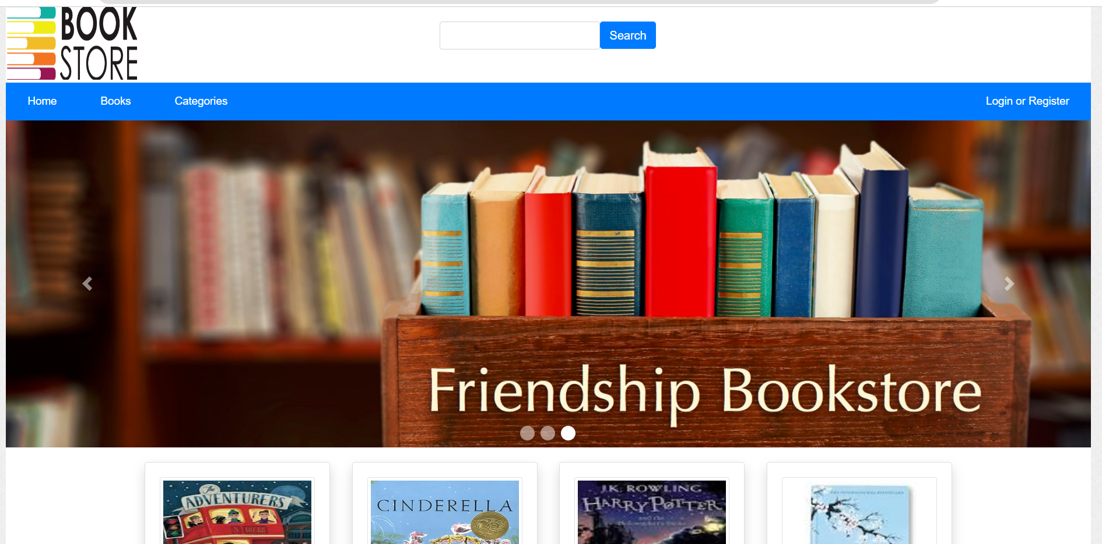
HOME PAGE

Slide 7
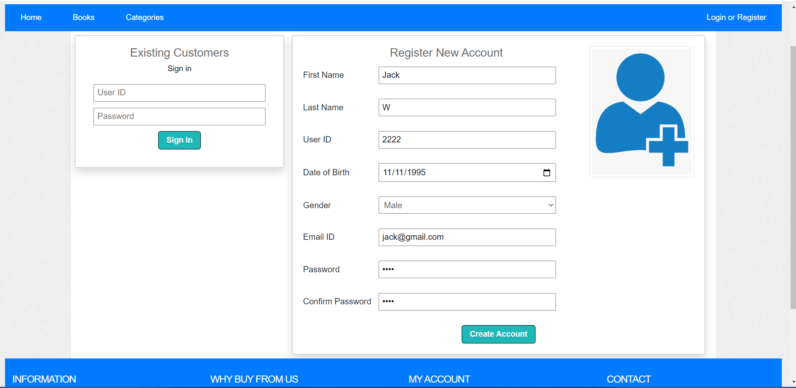
Login Page

Slide 8
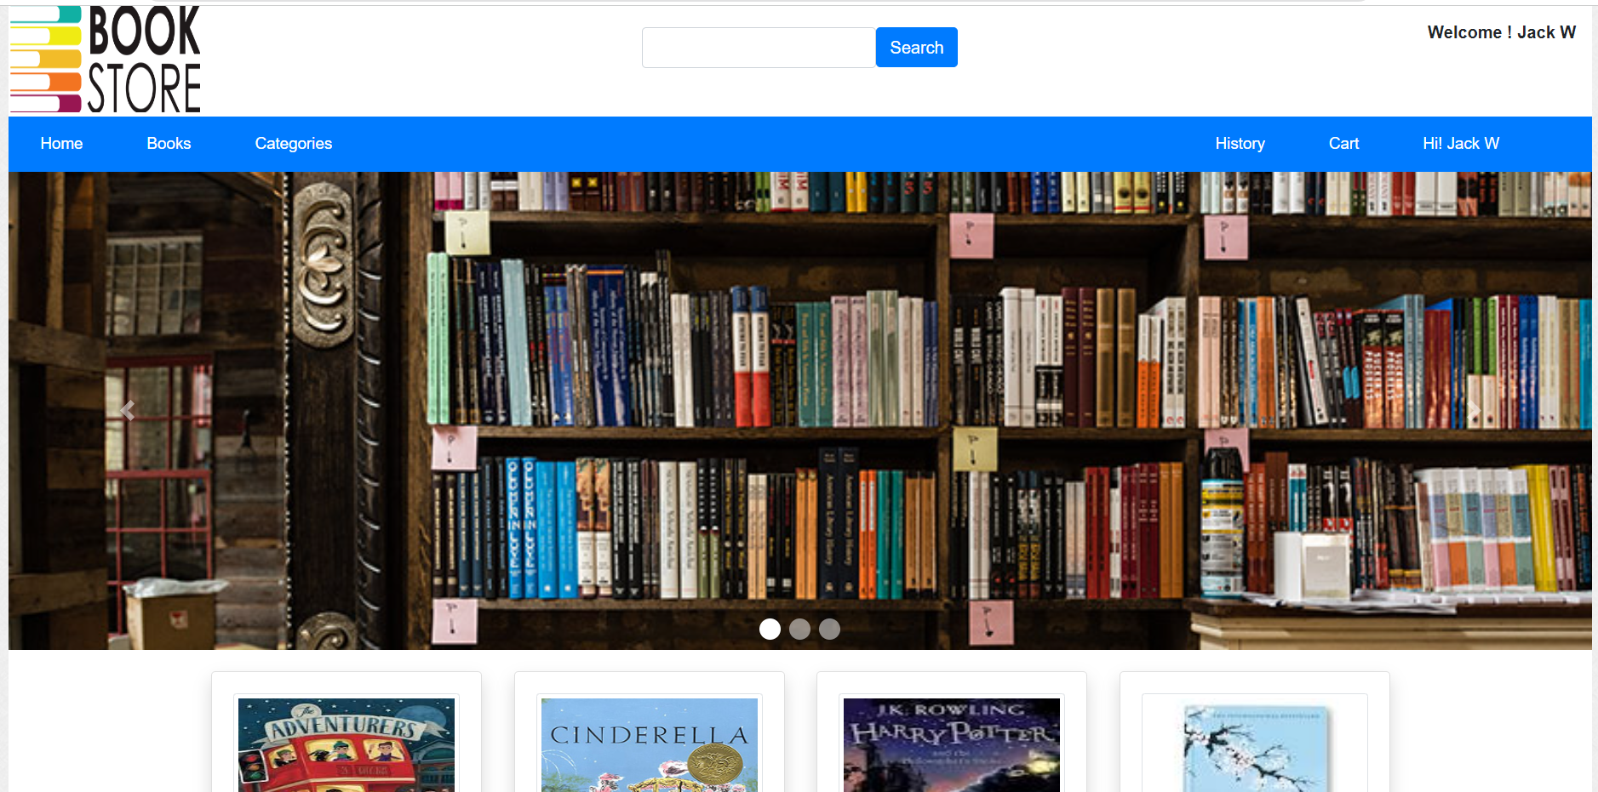
Myprofile:-

Slide 9
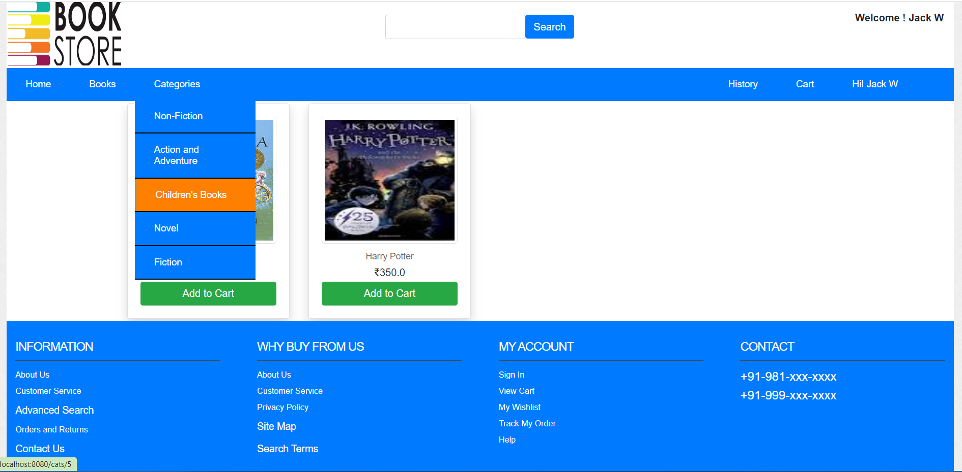
Categories

Slide 10
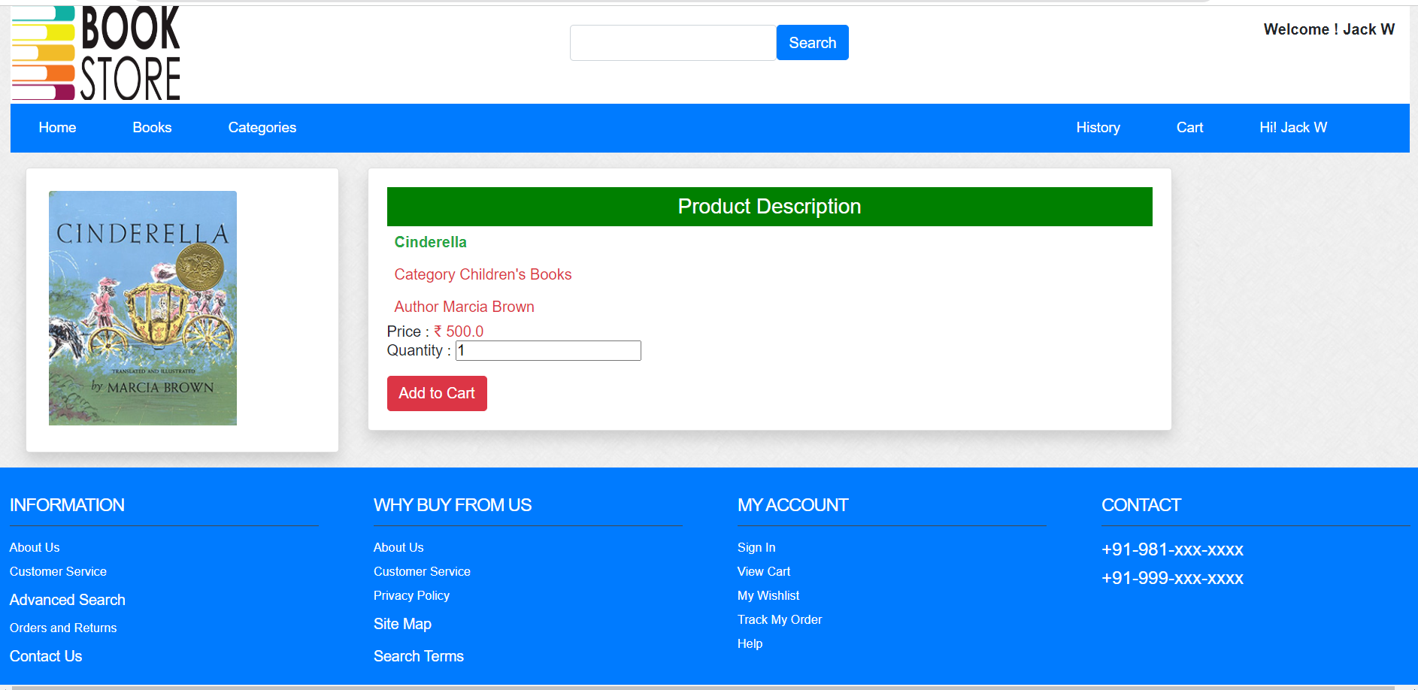
Product Description

Slide 11
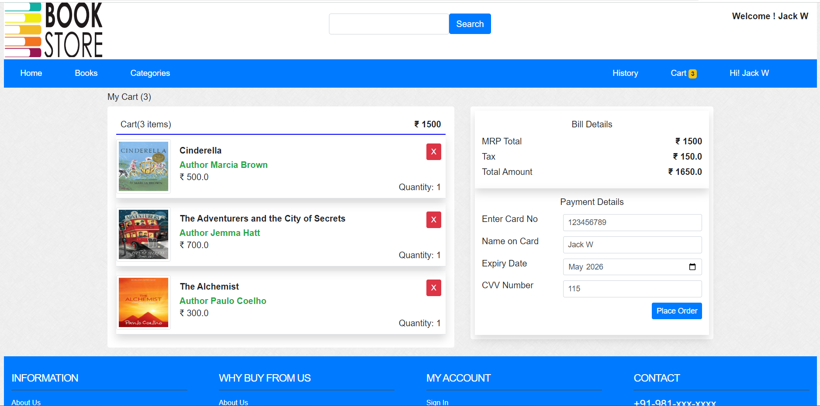
Cart

Slide 12
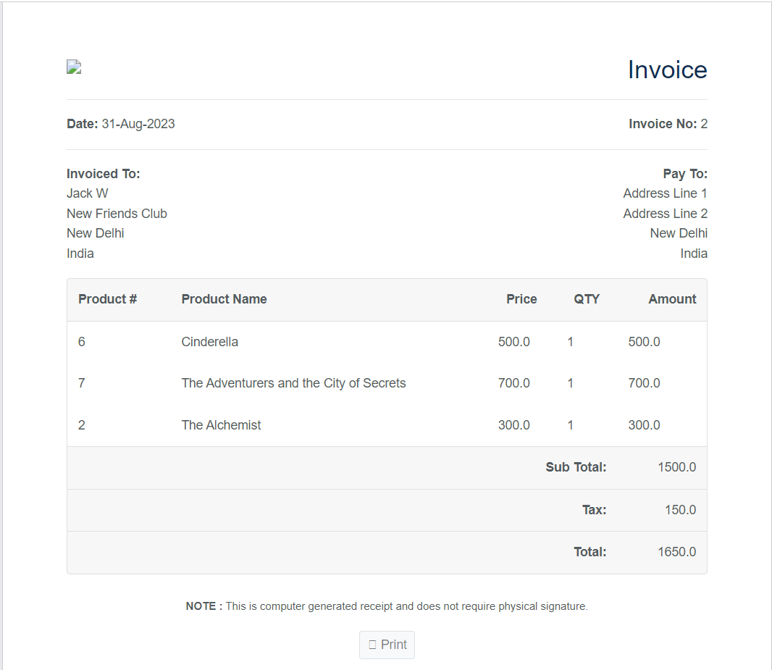
Invoice

Slide 13
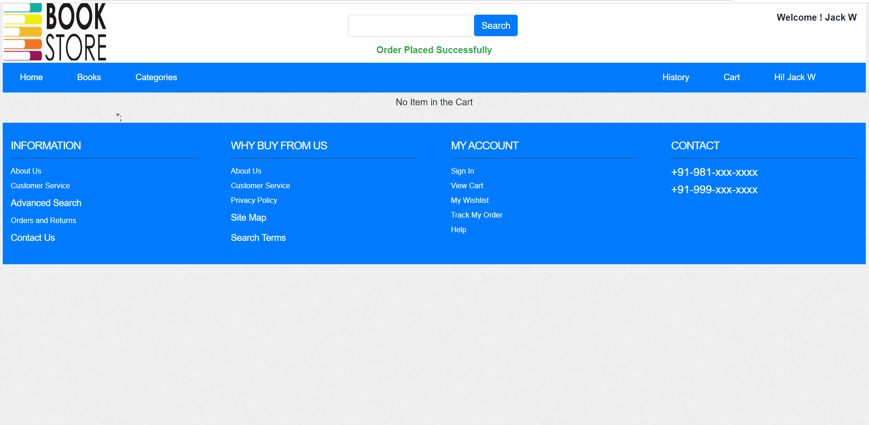
Order placed

Slide 14
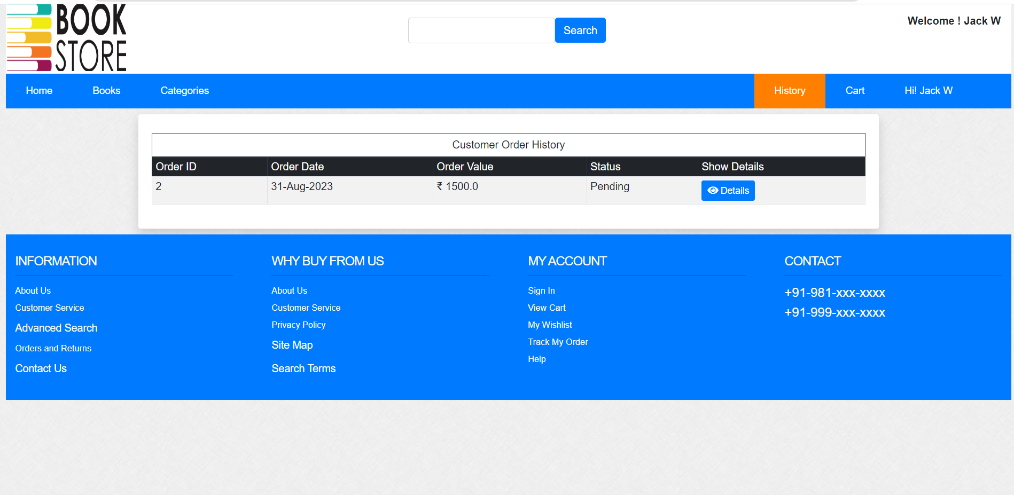
History

Slide 15
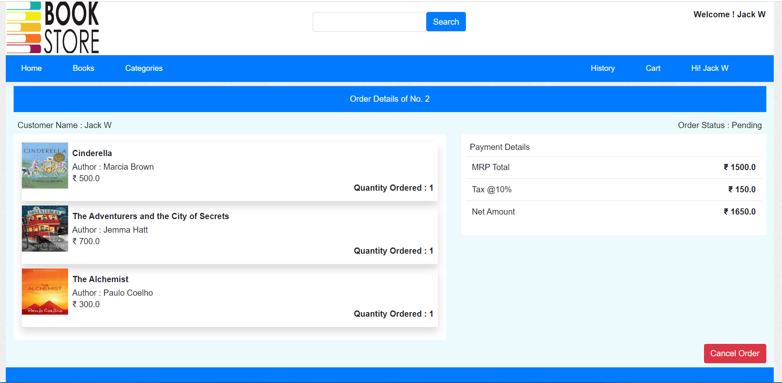
History details

Slide 16
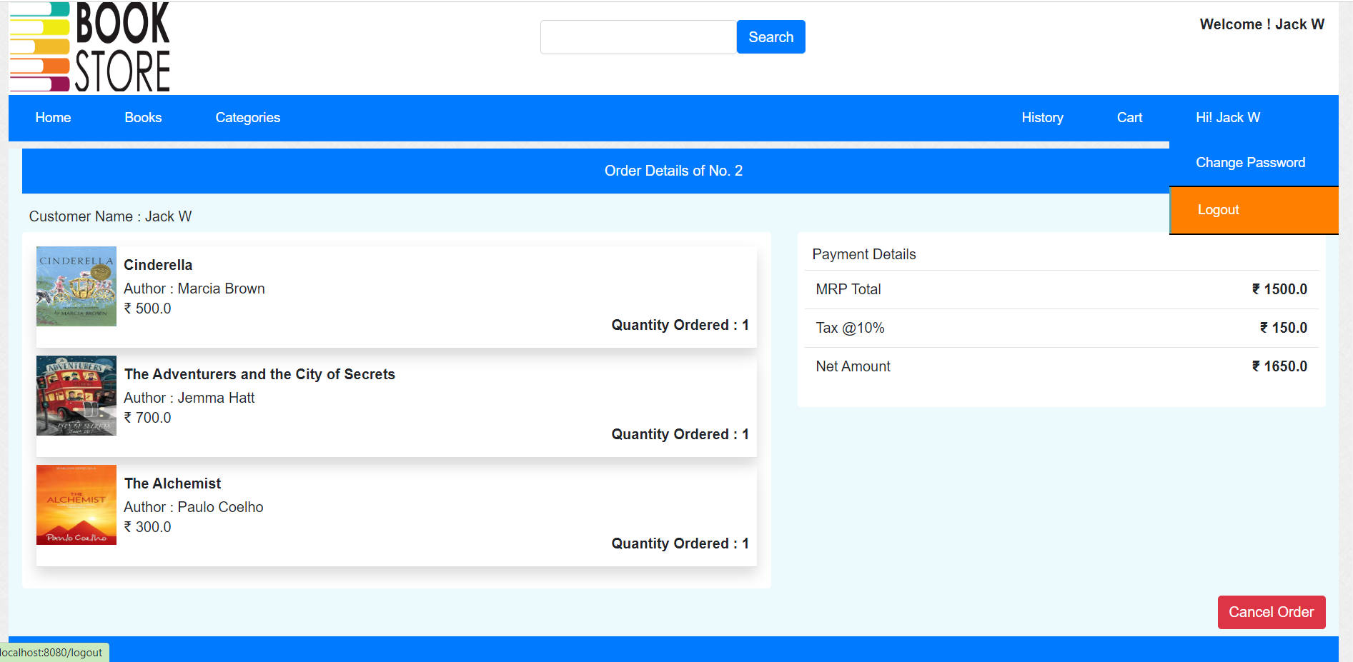
Logout

Slide 17
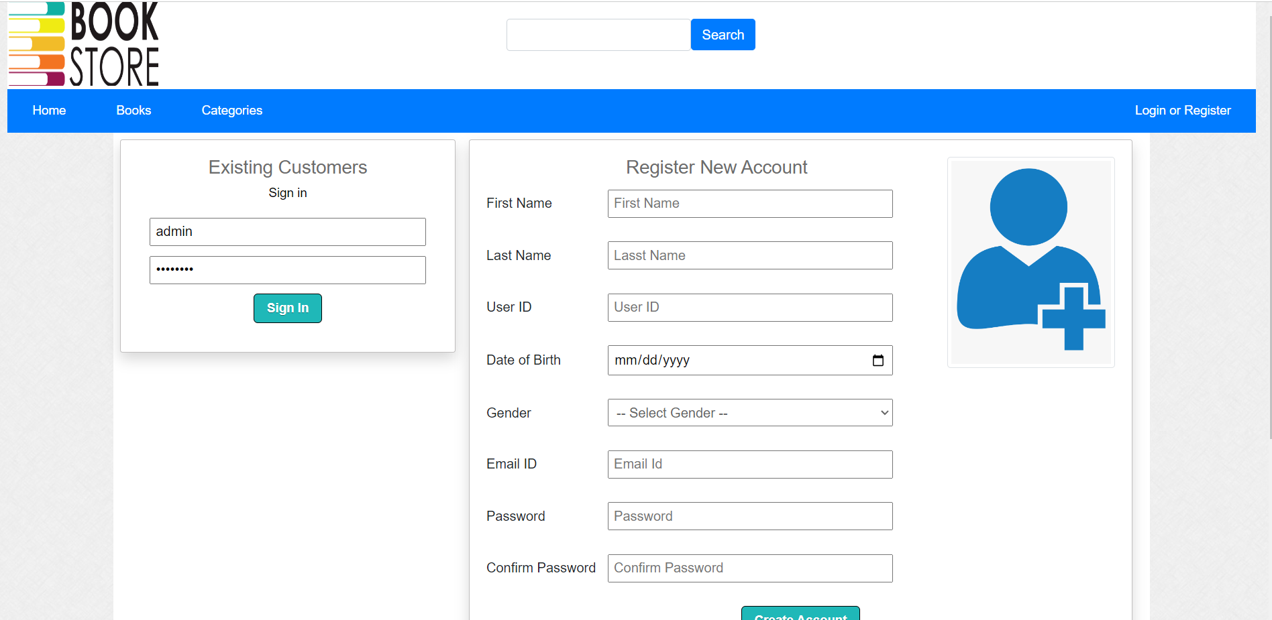
Admin Login

Slide 18
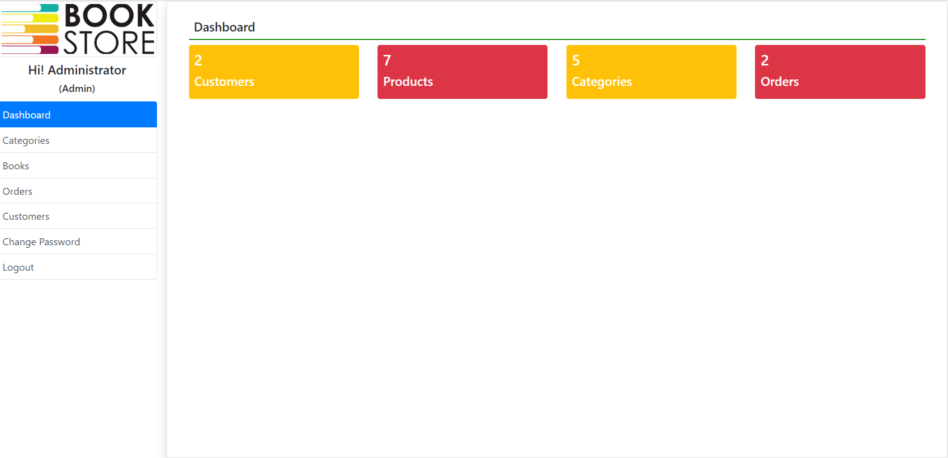
Admin profile

Slide 19
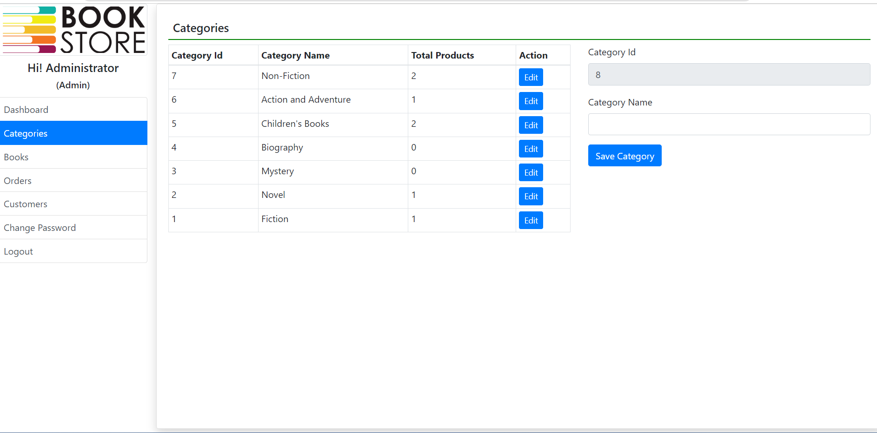
Categories

Slide 20
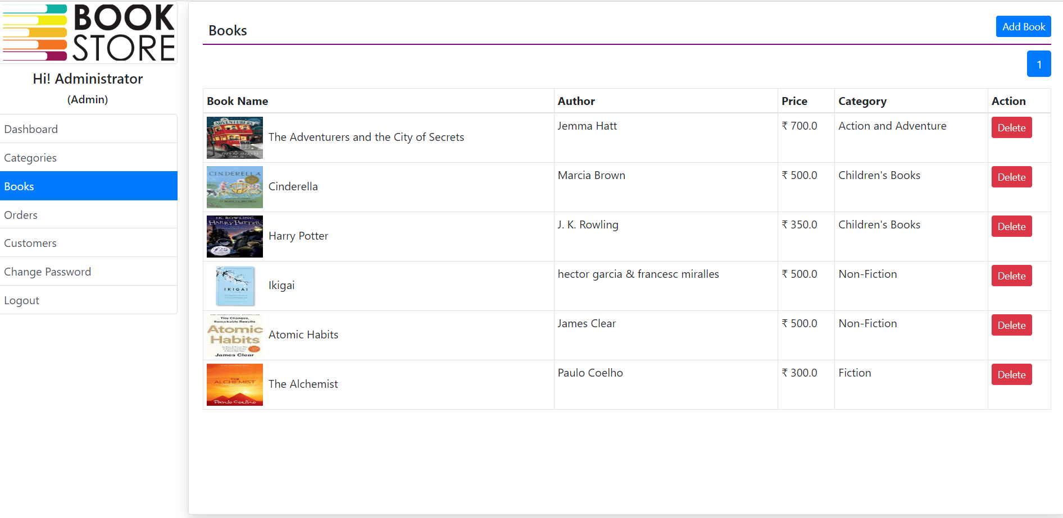
Book list

Slide 21
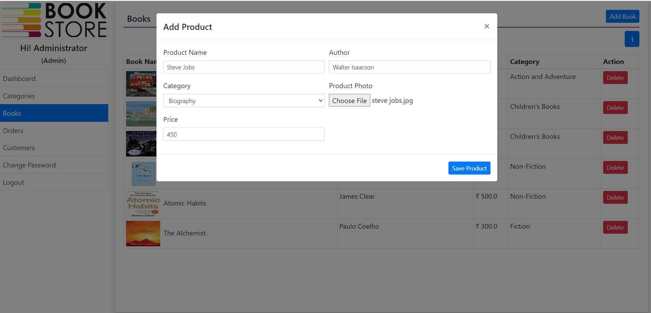
Add New Book

Slide 22
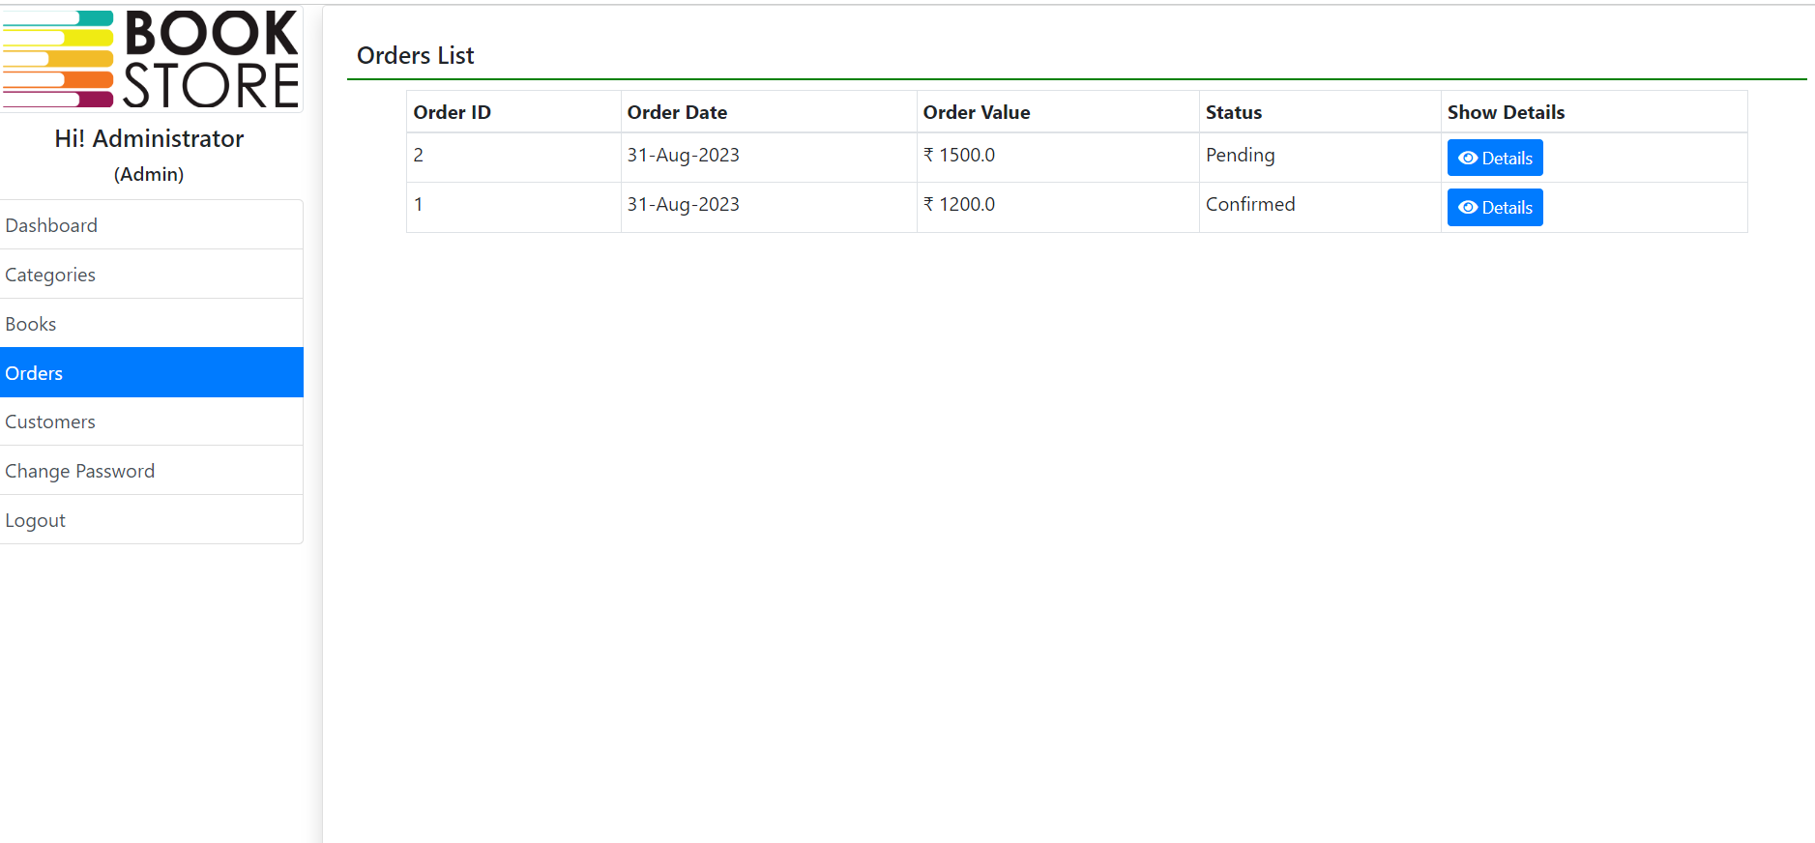
Orders

Slide 23
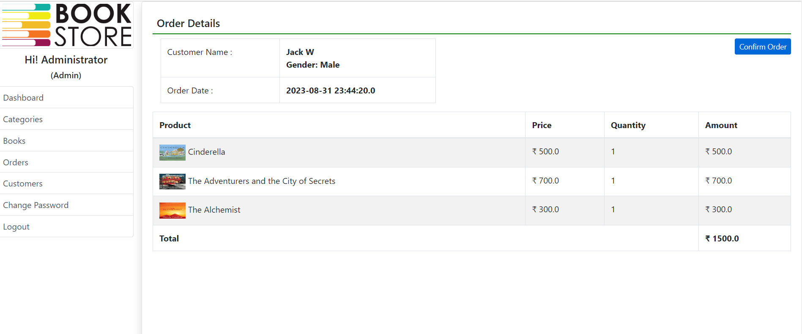
Order details

Slide 24
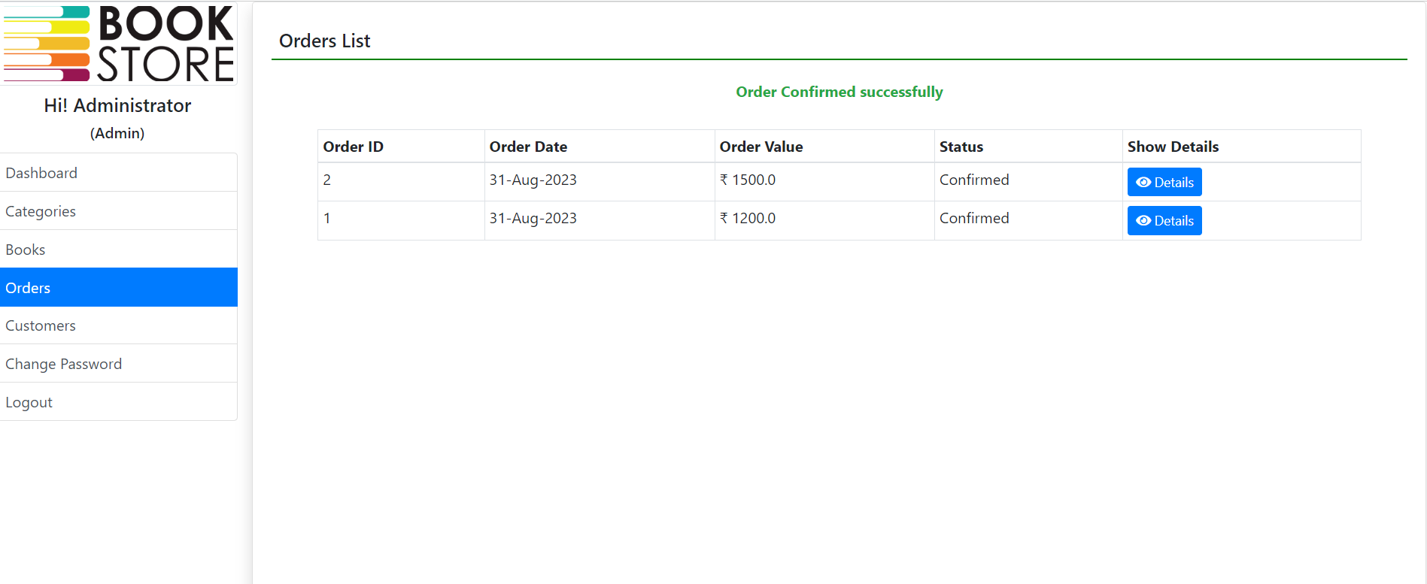
Confirm Order

Slide 25
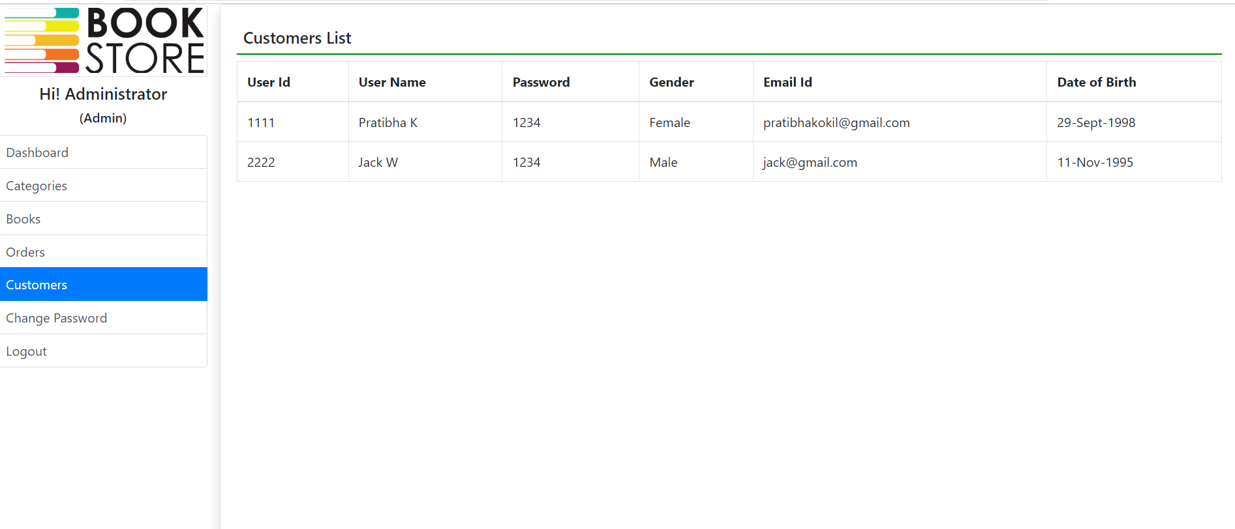
Customer list

Slide 26
Advantages:-
Customer Convenience
Ability to compare prices and availability across different retailers.
Cost saving
Time saving
Fast purchasing
Views books of all categories

